Slide 1
Practical Assurance Case Design
IV&V Workshop
S. R. Brown
KeyLogic Inc
With my thanks and appreciation
Don Ohi – Project Monitor
Travis Dawson – Chief Engineer
Bill Stanton for tolerating a lot of questions

Slide 2
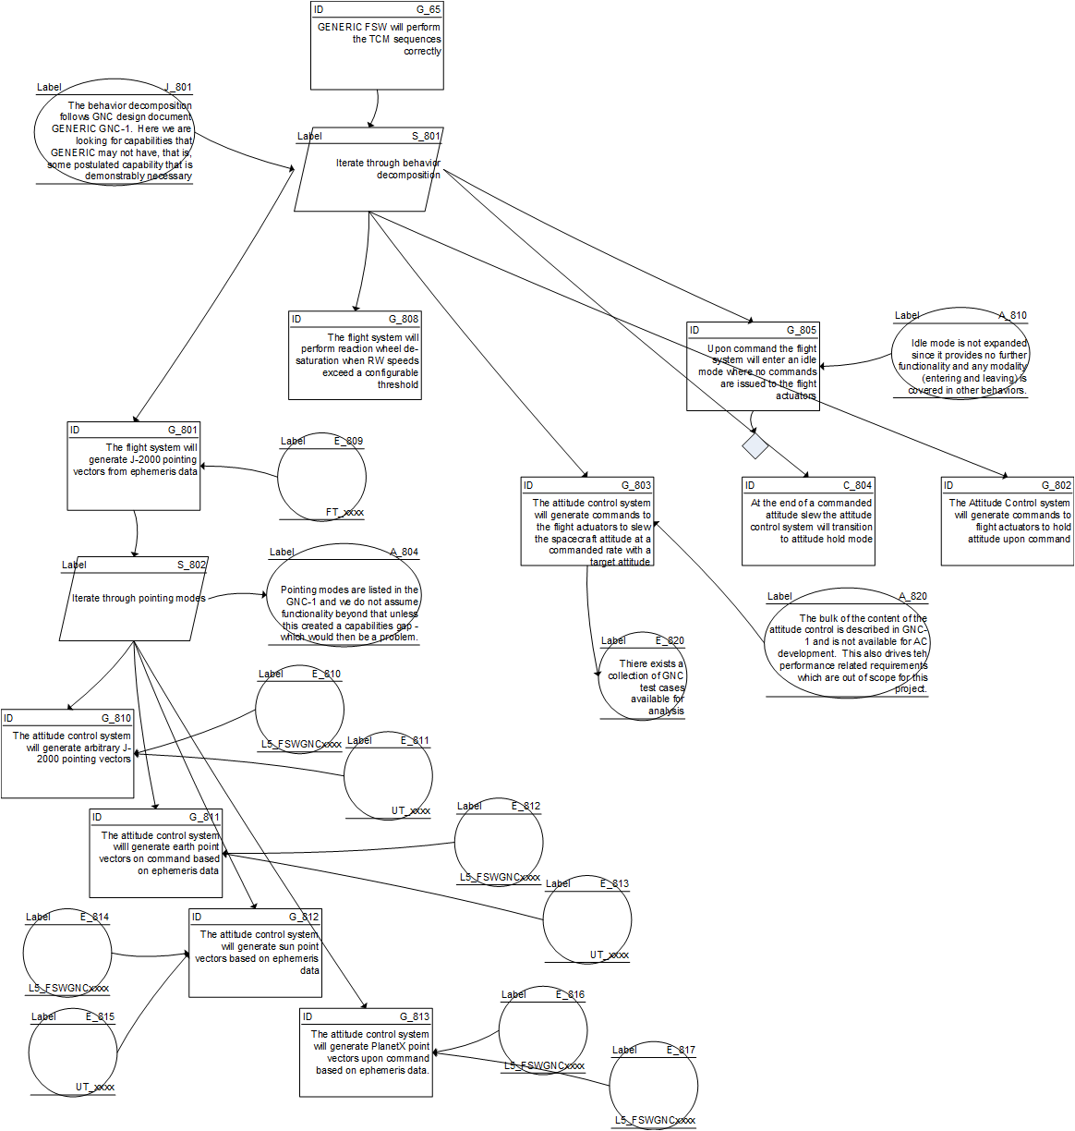
Why Assurance Cases
Related to:
Argumentation
Safety Case
State your case:
What are we trying to prove
How are we trying to prove it
What evidence supports the proof
Assurance Cases make the point
Design of Assurance
Support of Assurance
GSN Standard Kelly, T.: 'Arguing Safety: A Systematic Approach to Managing Safety Cases', D.Phil Thesis, University of York (1998). Available for download from http://www-users.cs.york.ac.uk/~tpk

Slide 3
State Your Case
Top level Claim
Claim Justification
Spousal Coffee Assurance Case
Perspective: Who is the stakeholder?

Slide 4
Make the Argument
Architectural decomposition
Behavioral decomposition

Slide 5
Gather the Evidence
Atomic evidence

Slide 6
Assurance Case Semantic Content
What I get out of a cup of coffee:
The assurance design is not a description of the system
Assurance network needs only to go as far as necessary to provide stated assurance
Strength of evidence is a constant consideration
Without more information there is little basis for claim prioritization
Can address risk (uncertainty)
Does not support consequence

Slide 7
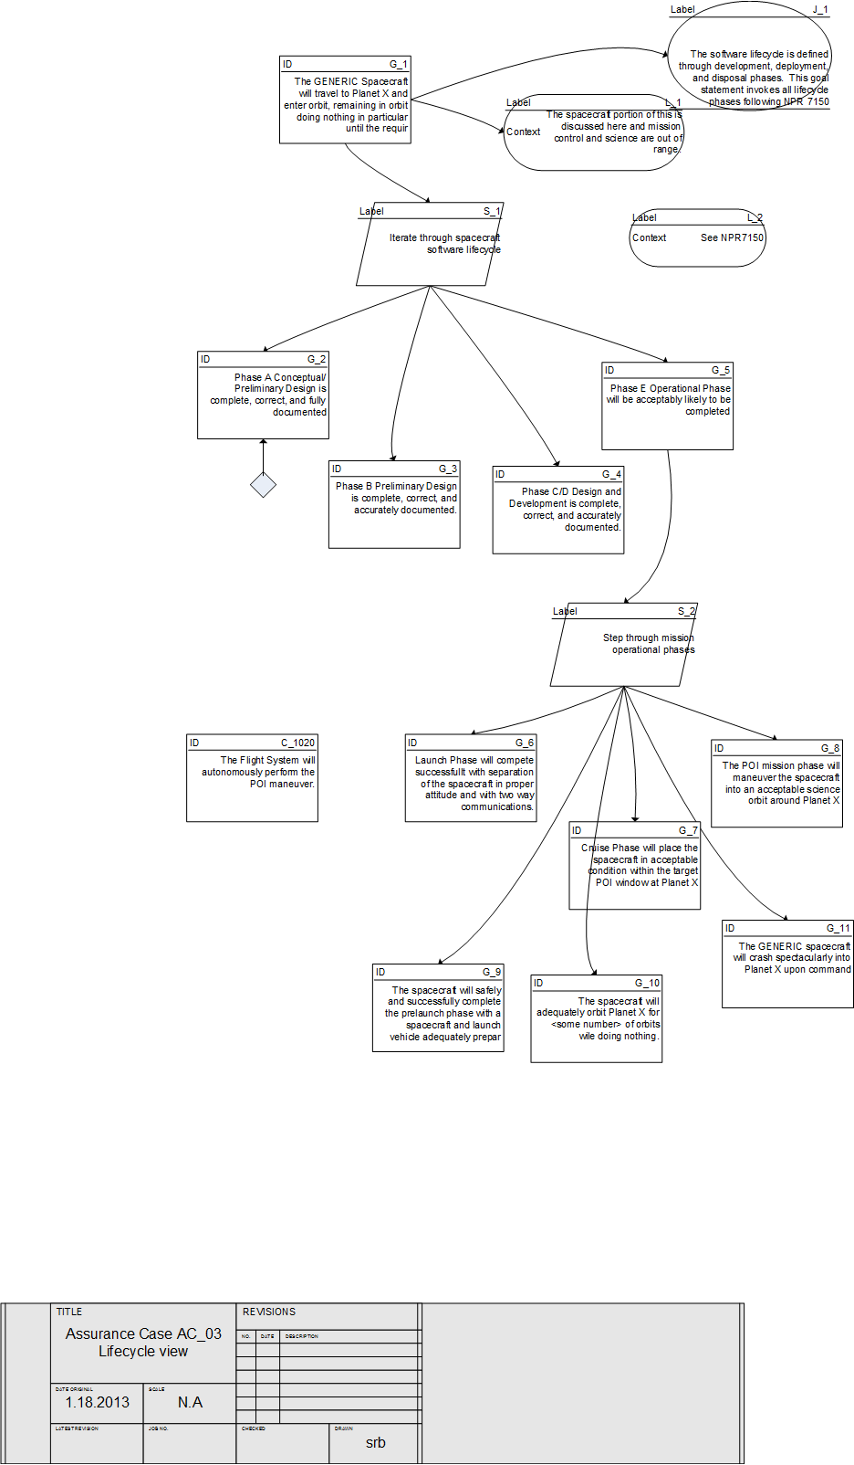
Where to Start
Is Clearly Stated
Testable (yes/no)
Initially a major goal: In almost every case it is self-evident if the objective is defined. This is where perspective becomes important. Consider stakeholder needs.
Will decompose in a useful way
Lessons Learned:
Look for simple and comprehensive claims
Claims must be objective (yes/no)
Watch out for claims that must decompose through out-of-scope domains (e.g.: reset/sideswap hardware timing)
Take advantage of self-similarity, patterns and common arguments.

Slide 8
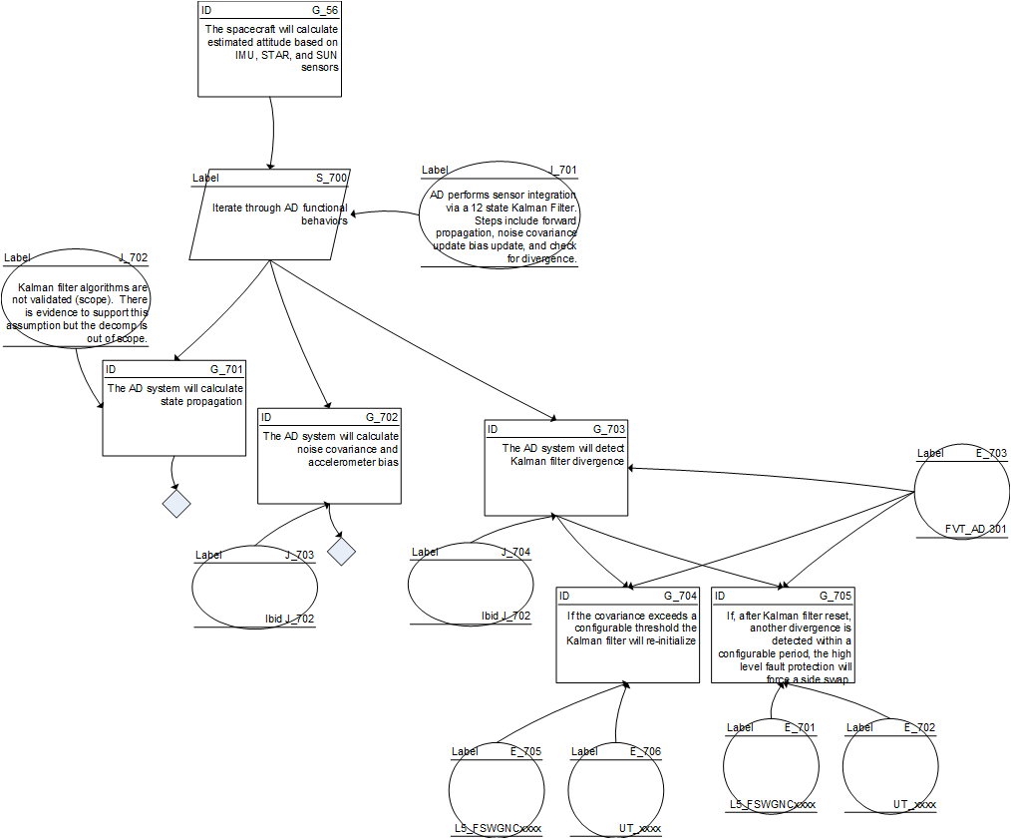
Perspectives and Planning
Represent the stakeholder
The perspective of the assurance case is important
Software lifecycle (NPR 7150)
System/Human safety
09-1 System definition
Project-specific
A place for (almost) everything
Decomposes differently than lifecycle

Slide 9
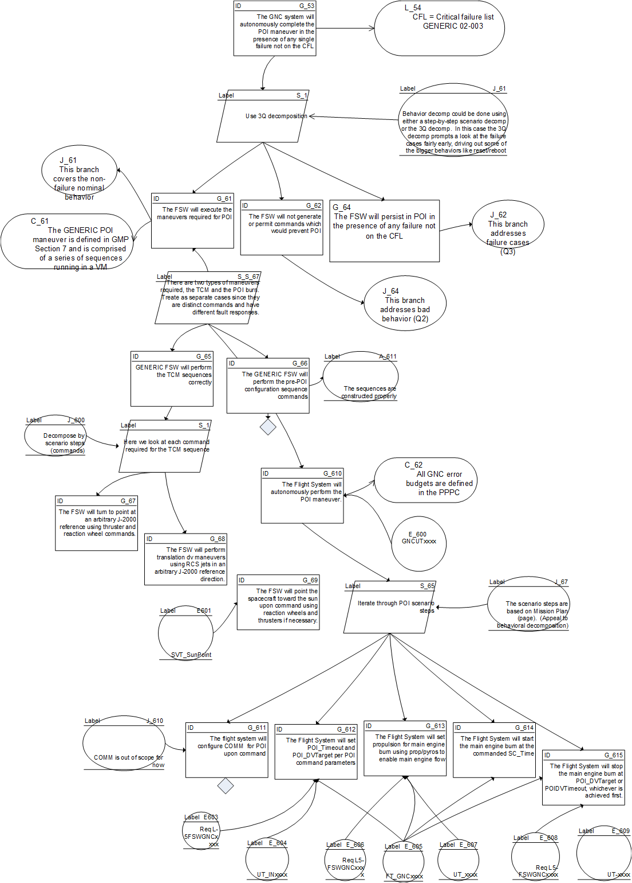
Argument: the Art of Assurance Case
Arguments are in the context of the system
Appeal to Specificity
Provide detail to support a more general claim
Little uncertainty
Arguments describe how the child claims satisfy the parent claim but do not carry the burden of proof
Some approaches require a justification for each argument but this was often redundant.
Assumptions are often necessary in order that the argument is clear to a reviewer
Some Useful decomposition classes
Appeal to Usage
Use scenario to decompose to subsystems by required actions
Some uncertainty
Appeal to architecture
Use software architecture to decompose to subsystems
No uncertainty
Note: 3Q is a special case of appeal to usage
Use cases can be a good basis for an Appeal to Usage. Note semantic equivalence.

Slide 10
When to Stop
Completeness
Are all claims fully decomposed?
Are all assumptions described?
Depth
Is there evidence that is directly relatable?
Abstraction
Are sub-claims at (more or less) the same level of abstraction?
Is evidence ascribed at the appropriate level of abstraction?
Generally the lowest level claim can be supported by one or more low level requirements.
Software architecture level
System-level tests and requirements are evidence too, but lower-level evidence is earlier in the project and often less ambiguous.

Slide 11
Top Down or Bottom Up?
GSN Standard describes both methods, then tosses in a third – use both.
Practical use dictates that both are necessary for IV&V
Top level claims provide the entire motivation for the assurance case
Evidence is determined by a combination of artifacts and IV&V analysis.

Slide 12
GENERIC PBRA Summary
GENERIC PBRA Summary
GNC Driver

Slide 13
Using the Assurance Cases with PBRA
We can map scenario steps to the assurance case because we used them for decomposition
Semantically, it seems that scenarios map to arguments (decomp by behavior), and scenario steps map to claims.

Slide 14
Odd topics
Where does static code analysis fit into the picture?
Certainly provides assurance in some sense
Applies to the product in general but traceable to architectural components
Claim: “Module XYZ is free of implementation flaws”
How does uncertainty fit into the picture?
IEEE15026 assumes there is a way to combine the independent (and ill-defined) components of uncertainty, or at least specify uncertainty.
Even if we could calculate uncertainty, would it be a Good Thing? Would broad categories be sufficient?

Slide 15
And now for something you will really like
Hot spots for development
Algorithmic blind spots
Scoring or ranking system
Real project testbed
Is a practical S/C assurance case possible?
Is a practical S/C assurance case useful?
Is it difficult to write top-level claims?
Is it difficult to develop arguments for decomposition?
Can this be a uniform and systematic process for each project?
Structured GSN
Yes
Yes – if well-designed
Not at all
Only in a few cases
Re-usability of assurance design

